Slide 1
Big Data challenge Datasets

Slide 2
Two Italian Cities
Milano – has more data sets
Trento – fewer data sets but has an electricity dataset
We focus on Milano

Slide 3
Milano Datasets
Geo Grid – used in all data sets
Traffic:
Congestion charge
GPS vehicle traces
Inductive-loop traffic detectors (yet to download)
News feed
Social Pulse – Milano (resulting from an elaboration based on twitter data)
Environment:
Environmental Air Quality
Weather
Precipitation
Telecoms
Phone within city
Phone to rest of country
Sms and internet usage
Other sources of data:
Milan open data repository:
http://dati.comune.milano.it/dato.html
(its in italian )

Slide 4
Vehicle

Slide 5
GPS vehicle traces
Cobra Telematics provides a service to insurance companies to track the cars of their customers via GPS. Insurance companies exploit GPS traces in order to offer additional services to the customers (e.g. satellite antitheft system and localization in case of emergency) and to determine who is responsible for a car accident. This dataset is based on the punctual fine-grained GPS readings collected in the Milan area. The location of a car is recorded every minute (only when the car is turned on) and they are aggregated as follows.
Spatial Aggregation: the Milano GRID square and the heading direction (north, east, south, west) of cars.
Temporal Aggregation: ten minutes.
Aggregated by groups of cars – generally 1-4 max
N/S/E/W heading given along with average speed

Slide 6
Mobility in Congestion charge
http://en.wikipedia.org/wiki/Milan_Area_C
Area C is a congestion charge in Milan and corresponds to the central Cerchia dei Bastioni area of Milan. The area is accessible through 42 gates monitored by video cameras
The dataset is composed by three sub-datasets.
Gate dataset: it provides information regarding the gates monitoring the Cerchia dei Bastioni area.
Vehicle dataset: it provides information regarding the vehicles which have passed through one of the gates at least once during the months of November and December.
Transit dataset: it provides information regarding the vehicle transits through the gates monitoring the Cerchia dei Bastioni area.

Slide 7
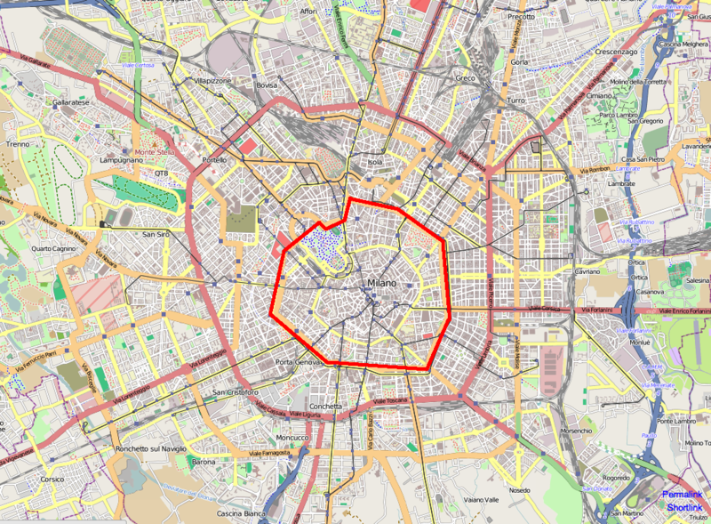

Slide 8
Congestion Charge data
Transit dataset:
Timestamp: the day and the time of the transit. TYPE: YYYY-MM-DD hh24:mi:ss.
Plate: the encrypted plate of the vehicle performing the transit. TYPE: string
Gate: the id of the gate that the transit took place. TYPE: numeric

Slide 9
Congestion charge vehicle data
Plate: the encrypted plate of the vehicle.
European emission standard category: the European emission standard category of the vehicle - 0 and 1-7
Vehicle type: the type of the vehicle. 0: not available 2: bus 3: freight transport 4: people transport 1: other
Fuel type: the kind of fuel used by the vehicle. It can have one of the following values:
0: not available / 1: petrol / 2: diesel / 3: electric / 4: LPG/natural gas /5: Hybrid
DPF: the availability of a diesel particulate filter.
Length: the length of the vehcile expressed in millimeters.

Slide 10
Bikes
Milano has a bike rental scheme
Limited data available
http://en.wikipedia.org/wiki/BikeM
https://www.bikemi.com/en/sitemap.aspxi

Slide 11
Todo – Induction loop data
Vehicle movement data just released

Slide 12
Environmental

Slide 13
Air Quality
36 sensors some measuring daily some minute by minute
Ammonia
Benzene
Nitrogene Dioxide
Sulfur Dioxide
BlackCarbon
Carbon Monoxide
Total Nitrogen
PM10 (SM2005)
PM2.5
Ozono
Ozone
This information is directly provided by ARPA (Agenzia Regionale per la Protezione dell’Ambiente) at the following website.

Slide 14
Weather Data
Temporal aggregation: 1 hour
33 sensors at seven locations
The sensors can measure different meteorological phenomena:
Wind Direction
Wind Speed
Temperature
Relative Humidity
Precipitation
Global Radiation
Atmospheric Pressure
Net Radiation

Slide 15
Precipitation
Grid for city is 2x2 squares
The precipitation intensity ranges among the following values:
0 Absent (0mm)
1 Slight (between 0mm and 2mm)
2 Moderate (between 2mm and 10mm)
3 Heavy (between 10mm and 100mm)
The precipitation :
0 Absent
1 Rain
2 Snow

Slide 16
Telecoms

Slide 17
Within Milan
Square id1: the id of the square of the Milano GRID which is the origin
Square id2: the id of the square of the Milano GRID which is the destination
Time Interval: the beginning of the time interval (10min intervals)
Directional Interaction Strength: the value representing the directional interaction strength between the Square id1 and the Square id2. This value is proportional to the number of calls exchanged between callers located in the Square id1 and receivers located in the Square id2. TYPE: numeric

Slide 18
Milan to Provinces
The level of interaction between an area A of Milan and a province B is given as a pair of decimal numbers. The first number is proportional to the number of calls issued from the area B to the province A, the second one is proportional to the number of calls from the province A to the area B.
Spatial Aggregation: the Milano GRID squares and the Italian provinces.
Temporal aggregation: the values are aggregated in timeslots of ten minutes

Slide 19
SMS Call internet
The dataset is the result of a computation over the Call Detail Records (CDRs) generated by the Telecom Italia cellular network over the city of Milano. CDRs log the user activity for billing purposes and network management. There are many types of CDRs, for the generation of this dataset we considered those related to the following activities:
Received SMS: a CDR is generated each time a user receives an SMS
Sent SMS: a CDR is generated each time a user sends an SMS
Incoming Calls: a CDR is generated each time a user receives a call
Outgoing Calls: CDR is generated each time a user issues a call
Internet: a CDR is generate each time
a user starts an internet connection
a user ends an internet connection
during the same connection one of the following limits is reached:​
15 minutes from the last generated CDR
5 MB from the last generated CDR
Temporal aggregation: activity measurements are obtained by temporally aggregating CDRs in timeslots of ten minutes

